Slide 1
BT201
Biochemical Process Calculations
02/11/2022

Slide 2



Energy balances
In biochemical process units such as bioreactors, distillation columns, evaporators, and heat exchangers, shaft work and kinetic and potential energy changes tend to be negligible compared with heat flows and internal energy and enthalpy changes.
Energy balances on such units therefore usually omit the former terms and so take the simple form (closed system) or (open system).
Closed system:
Open system:
Most of these operations involve the flow of fluids to, from, and between tanks, reservoirs, wells, and process units.
Accounting for energy flows in such processes is most conveniently done with mechanical energy balances

Slide 3




Cont..
Liquid flowing into and out of a process system at steady state (open system)
A single incompressible liquid flowing into and out of a process system at steady state
The shaft work is the work done by the fluid on moving elements in the process line.

Slide 4


Cont..
In many cases only slight amounts of heat are transferred to or from the surroundings, there is little change in temperature from inlet to outlet, and or reactions occur.
Even under these circumstances, some kinetic or potential energy is always converted to thermal energy as a result of friction due to the movement of the fluid through the system.
In consequence, the quantity termed the friction loss and is given the symbol
This energy balance equation it is valid for steady state flow of an incompressible fluid.

Slide 5

Bernoulli equation
Simplified form of the mechanical energy balance is obtained for frictionless processes =0
in which no shaft work is performed ( =0)
Bernoulli equation.

Slide 6
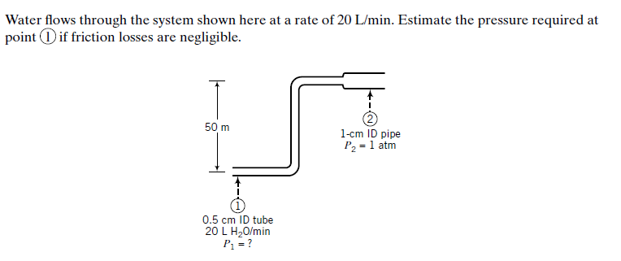

Slide 7
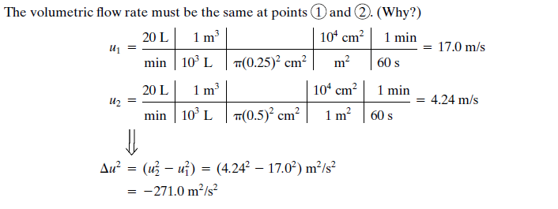
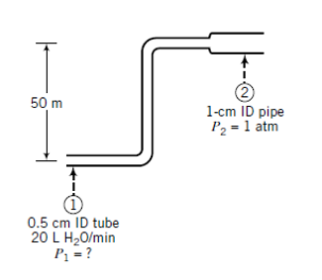

Slide 8
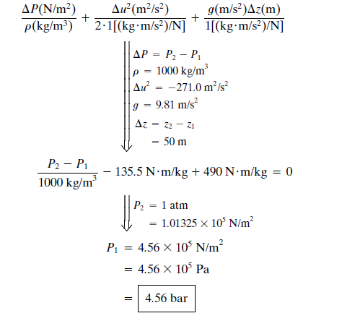

Slide 9
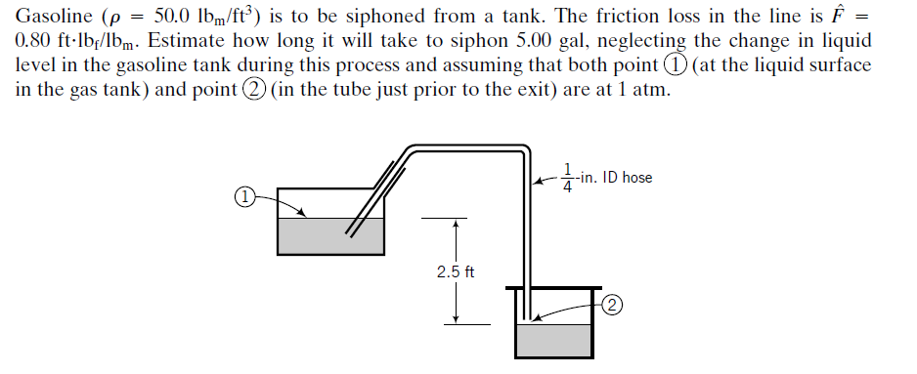


Slide 10

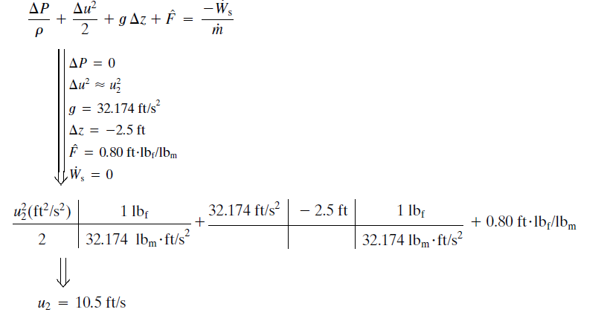

Slide 11
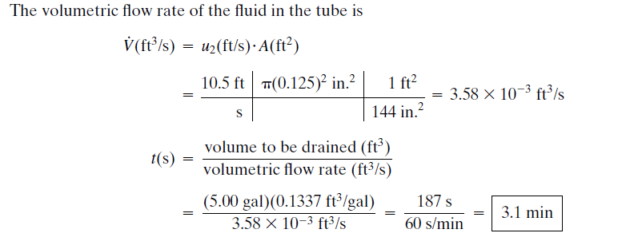

Slide 12
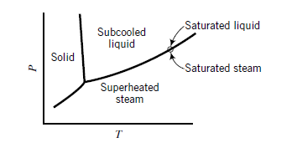
Steam Tables
Compilations of physical properties of liquid water, saturated steam, and superheated steam issued in steam table have been standard references for mechanical and chemical/biochemical engineers involved with steam cycles
Pure water may coexist as liquid and vapor only at temperature–pressure pairs that fall on the
vapor–liquid equilibrium (VLE) curve.
At points above the VLE curve (but to the right of the solid–liquid equilibrium curve), water is a subcooled liquid
At points on the VLE curve, water may be saturated liquid or saturated steam (vapor) or a mixture of both. At points below the VLE curve, water is superheated steam

Slide 13
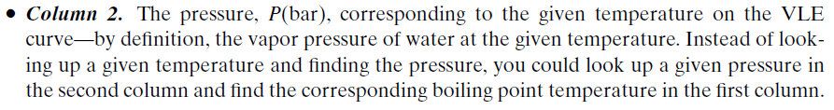
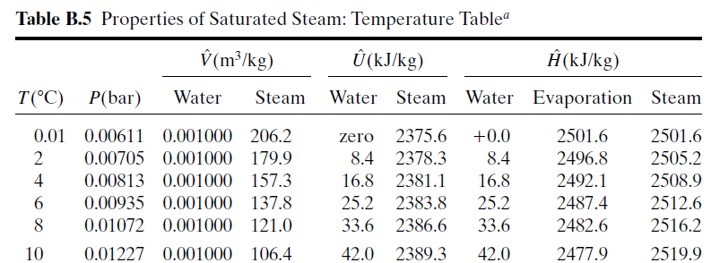
Cont..

Slide 14
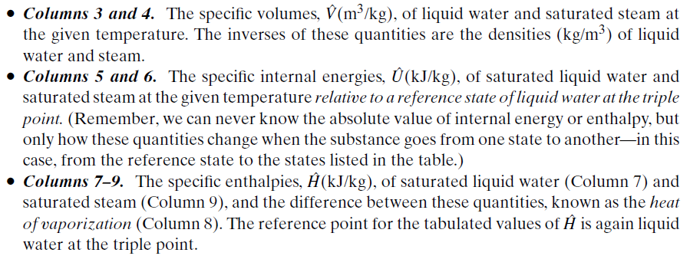

Slide 15
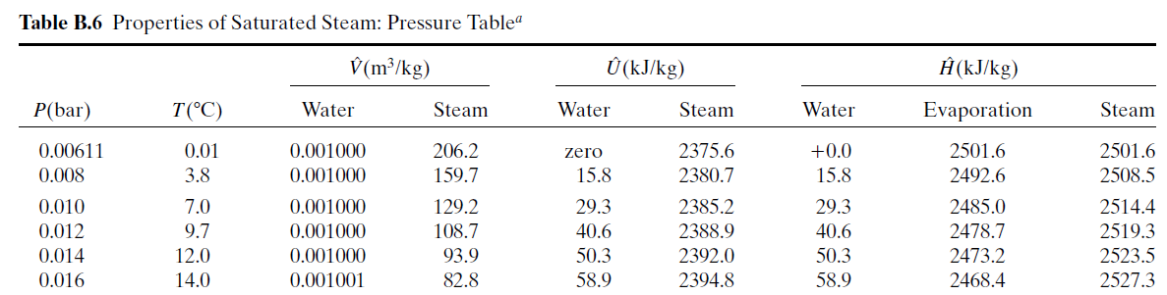
Table B.6 lists the same properties as Table B.5, except that pressure is the first column and temperature the second and the table covers a much broader range of temperatures and pressures.

Slide 16
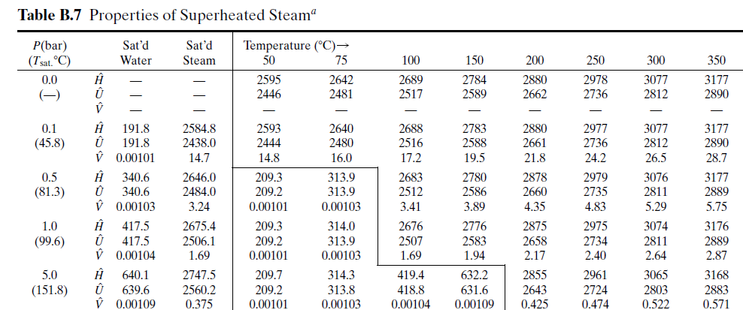
Specific enthalpy, entropy and specific volume at temperature and pressure, not just at points on the VLE curve.
If you are given a temperature and a pressure, you can locate the properties of water
If the intersection falls within the closed region on the table the water is a liquid; outside this region, it is a superheated vapor.

Slide 17
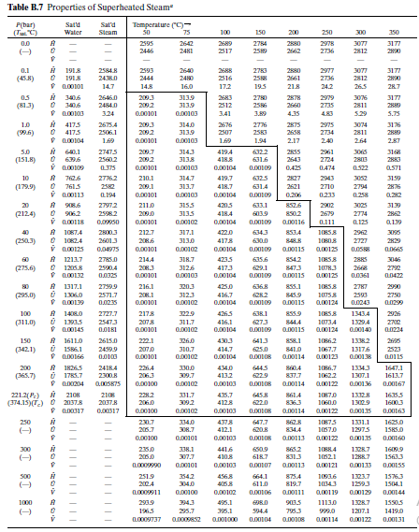

Slide 18
Cont.
When you look up a pressure in the first column of Table B.7, you will find just below it in parentheses the boiling point temperature and in Columns 2 and 3 the properties of saturated liquid water and saturated steam at that pressure.
If you are at a point in the superheated steam region, you can move all the way to the left to determine the saturation temperature at the same pressure, or the dew point of the superheated steam.

Slide 19
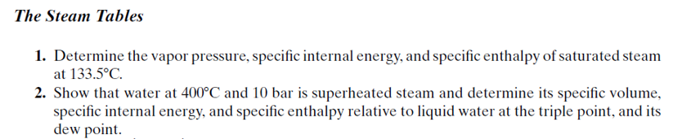
(Check full table in the book)

Slide 20
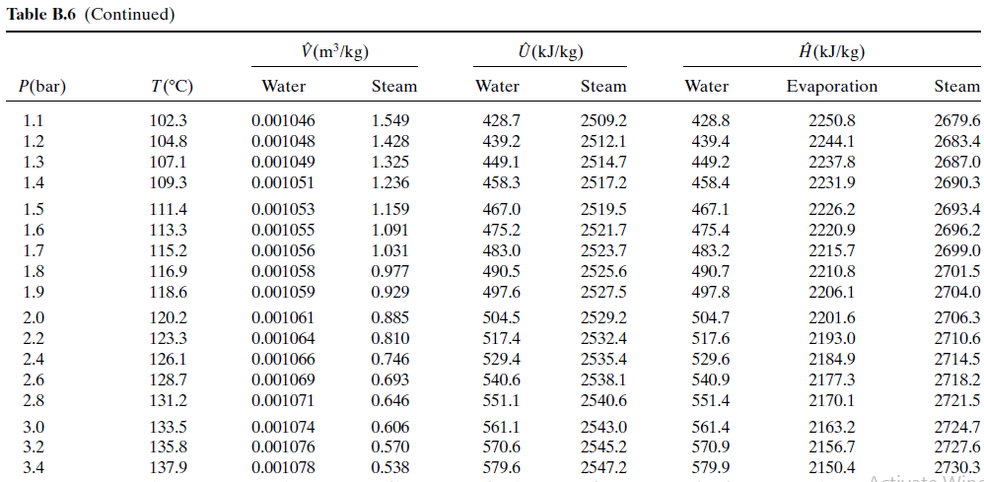
Properties of Saturated Steam

Slide 21
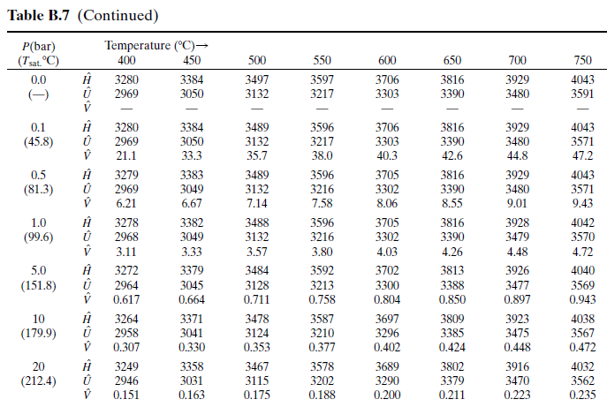
Properties of Superheated Steam

Slide 22
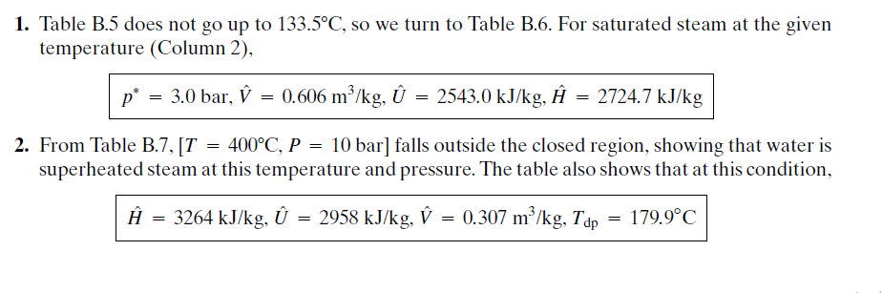
**Table: B5, B6 and B7 from Elementary Principle of chemical processes by Felder and Rousseau

